Slide 1


ايذاء الاخرين لفظيآ
Cyberbullying Detection
By:
John Hani
Mohamed Nashaat
Mostafa Ahmed
Zeyad Emad (Team Leader)
Under supervision of :
Dr. Eslam Amer, Dr.Ammar
Eng. Menna Gamil
Date:4\2\2019

Slide 2


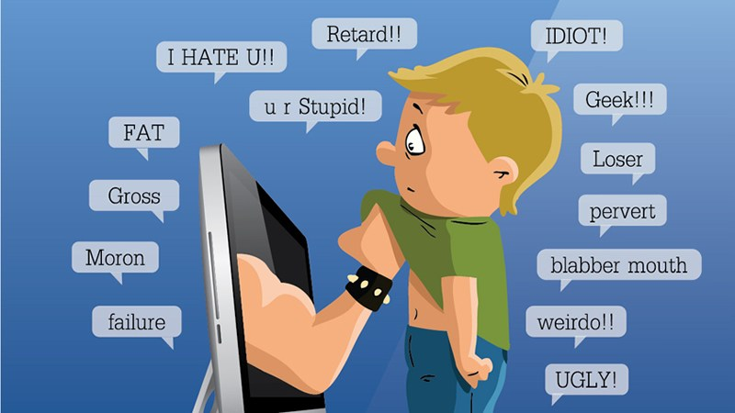
Introduction
What is cyberbullying?
The use of electronic communication to bully a personsending messages of an intimidating or threatening nature.

Slide 3



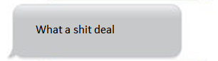
You’re
Trash
Personal pronoun used when directly addressing people
An offensive word when combined with personal pronouns creates a cyberbullying sample

Slide 4
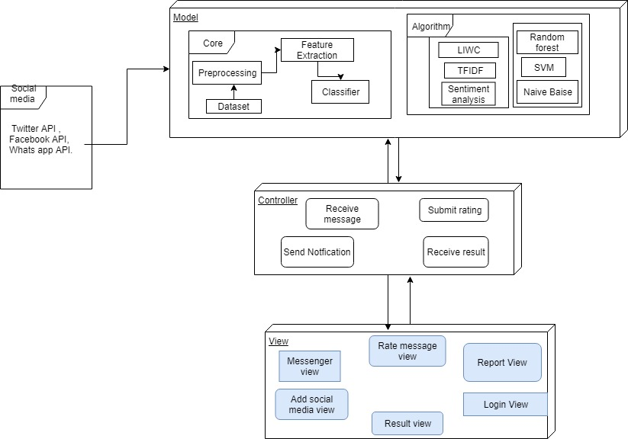
System Architecture
Feature
Extraction
Classifiers

Slide 5
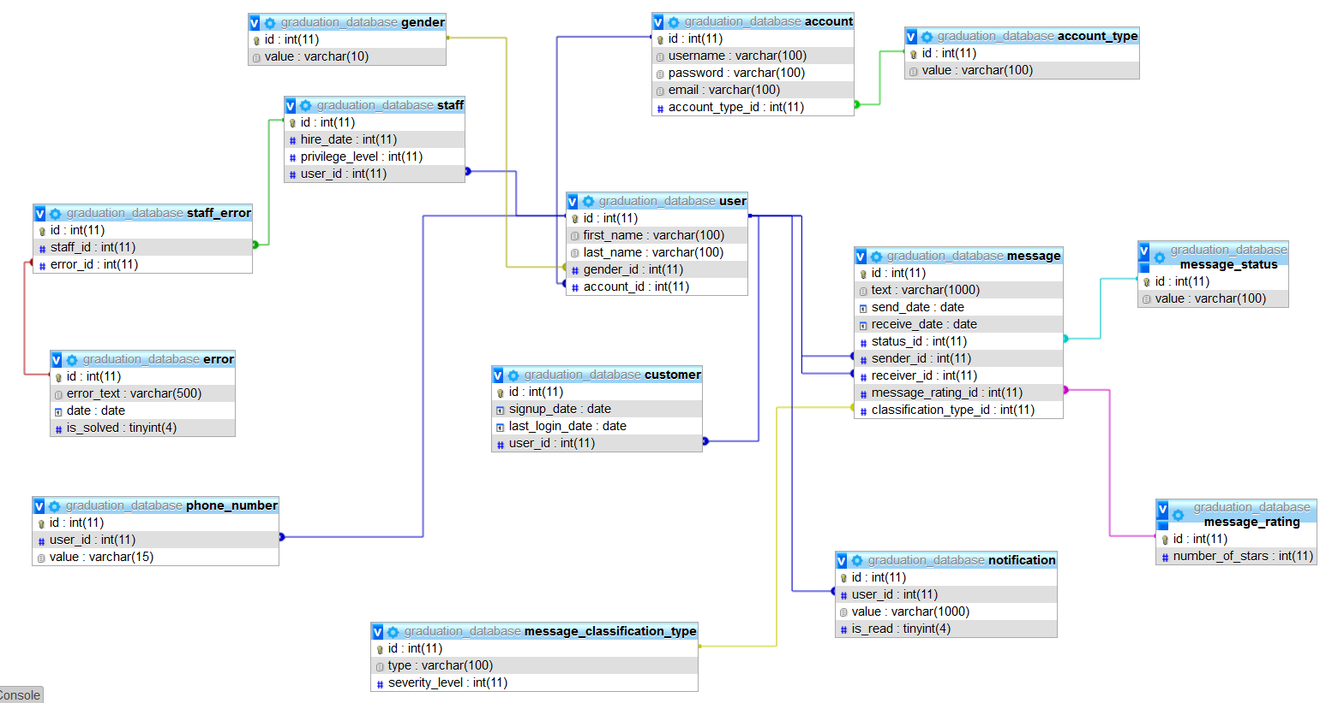
Database

Slide 6
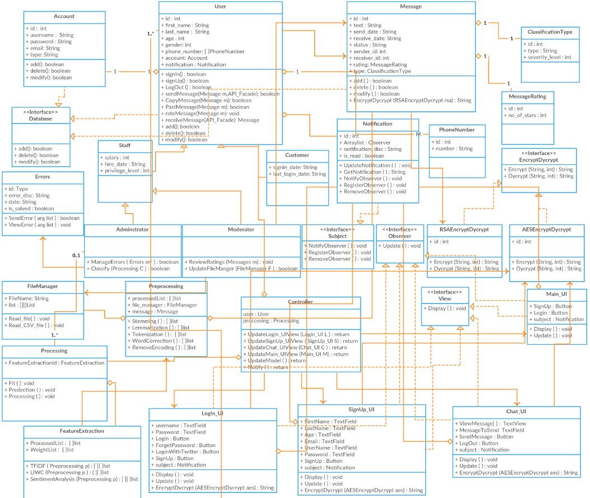
MVC Design Pattern

Slide 7
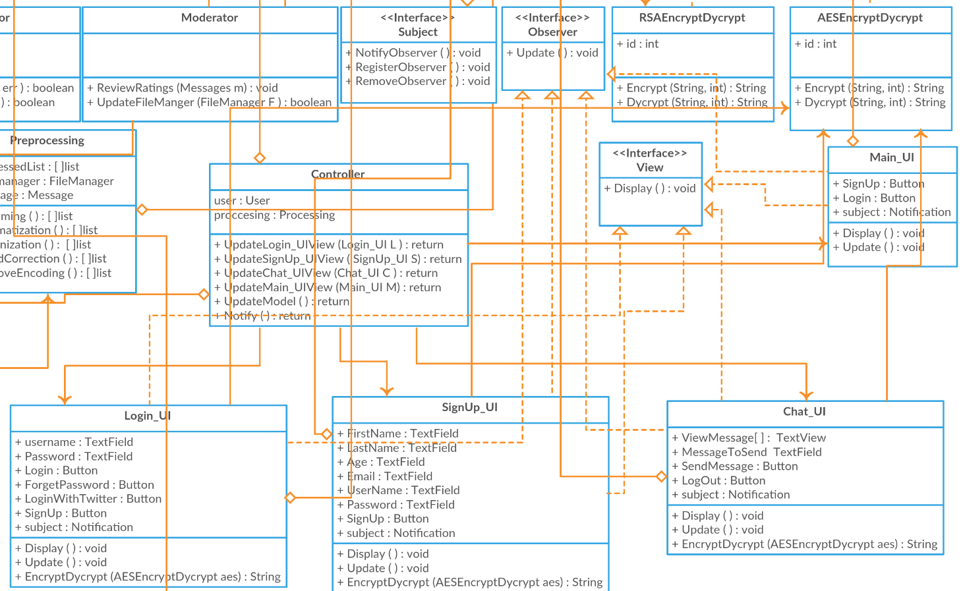
Observer Design Pattern

Slide 8
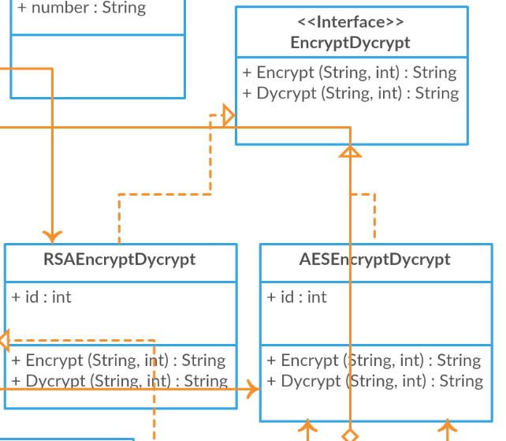
Strategy Design Pattern

Slide 9
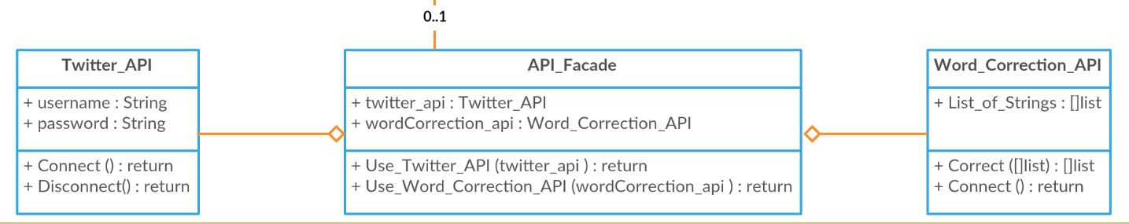
Facade Design Pattern

Slide 10
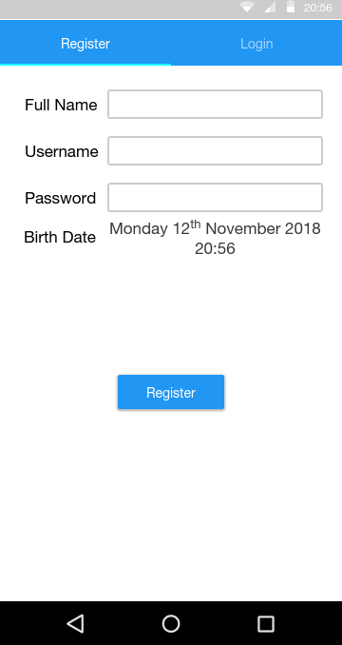
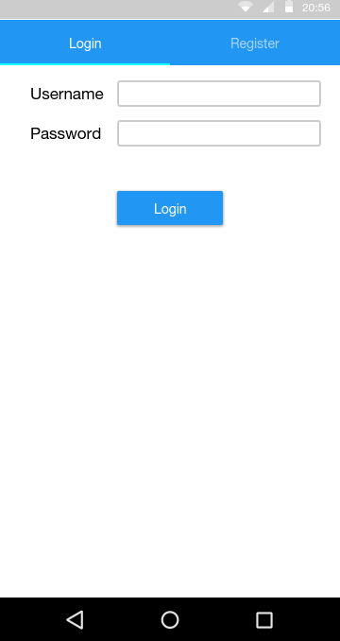
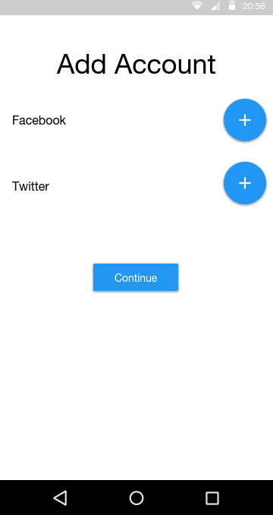
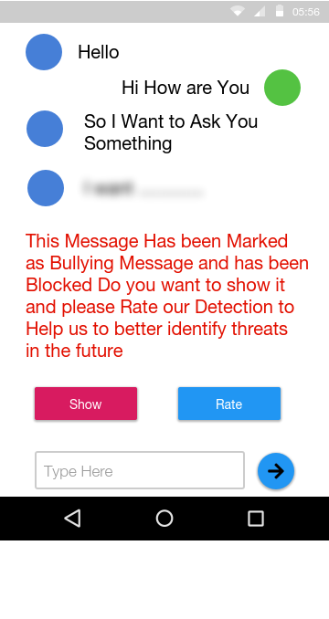
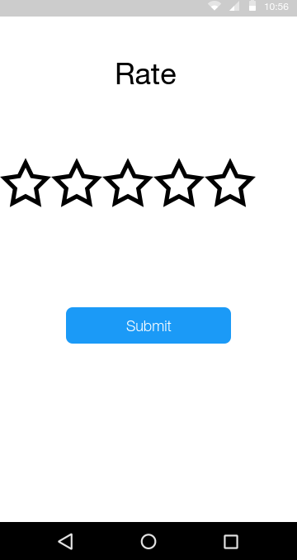
GUI

Slide 11
Design Rationale
Bag of words
Bag of word models don’t respect semantics of the word.
Logistic regression
is a statistical technique allowing researchers to create predictive models. t gives you a discrete binary outcome between 0 and 1. To say it in simpler words, it’s outcome is either one thing or another.
Skip gram
Failed to identify the combined word phrases.
Naïve Bayes
Naïve Bayes will have low recall and precision with small daataset.

Slide 12
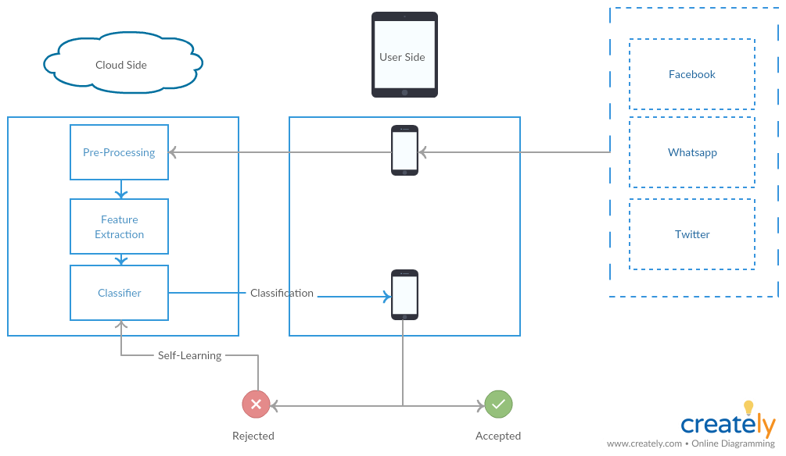



System Overview

Slide 13
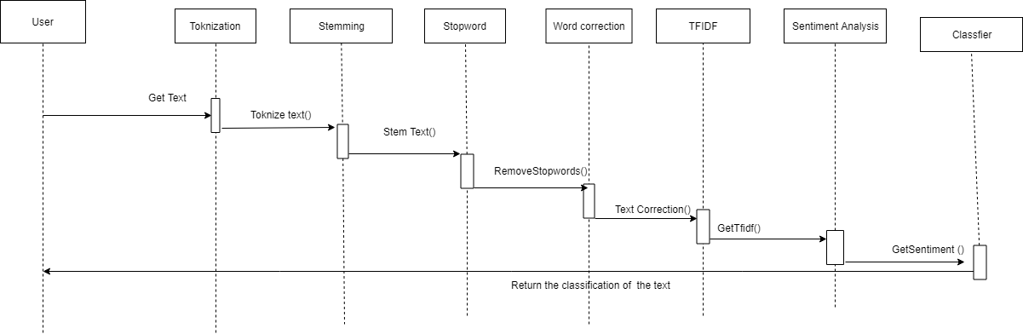

Slide 14
Demo

Slide 15
Any Questions ?

Slide 16
Appendix

Slide 17
Most Important Algorithm
Sentiment Analysis
What is Sentiment Analysis ?
Why we chose it ?
How it works ?

Slide 18
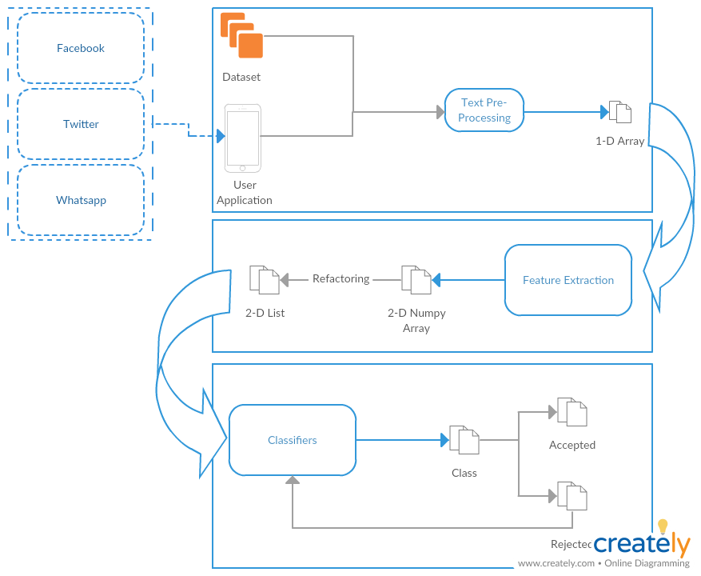
Business Model
Self Learning

Slide 19
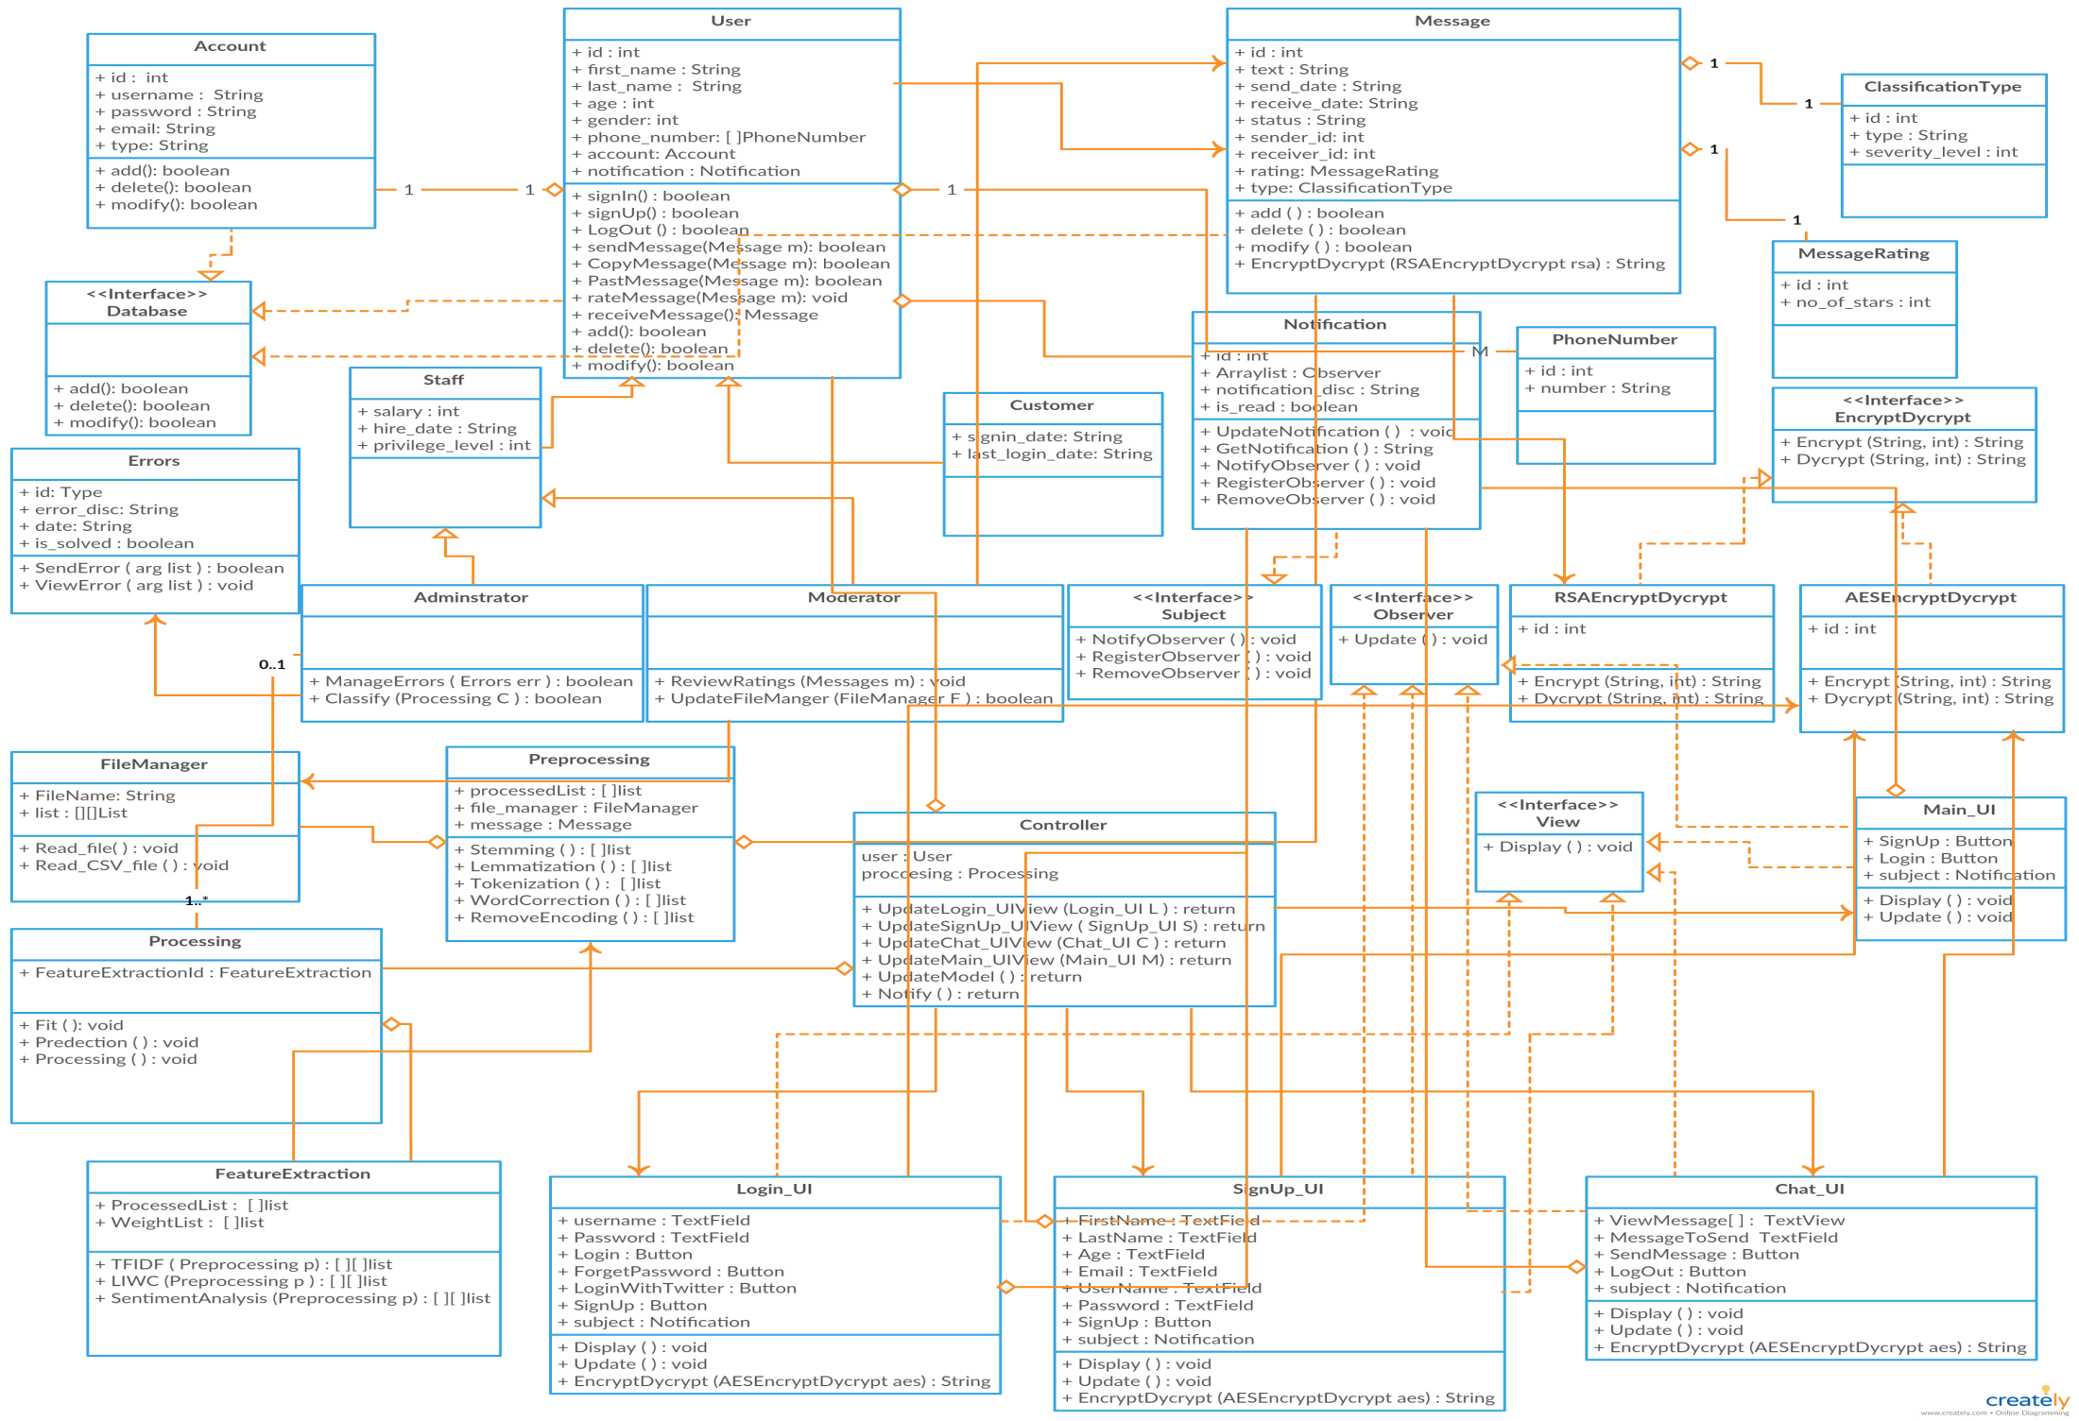
Class Diagram

Slide 20



Non Functional Requirements
Security
Maintainability
Portability
Have Encryption and Decryption
Self Learning
Both Desktop and Android

Slide 21
Market motivation

Slide 22
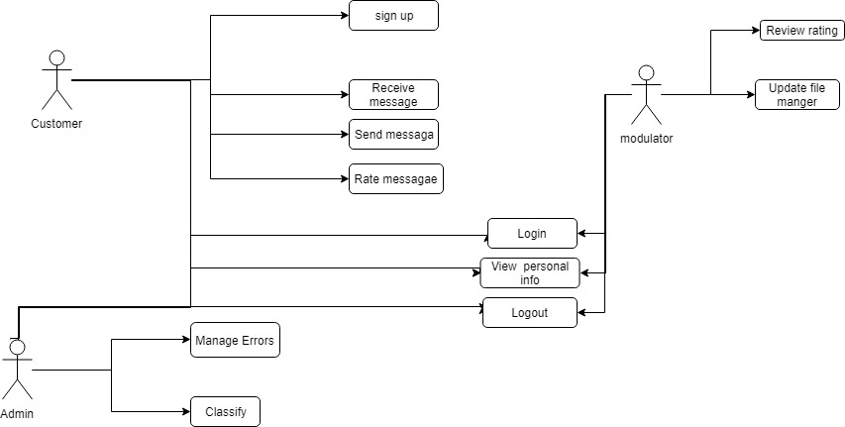
USE Case

Slide 23
Functional Requirement
User | Login with social media Rating
Messages | Send messages & Receive messages Encrypt & Decrypt
Processing | Preprocessing Feature extraction Classification
System | Notify Result Upgrade Classifier

Slide 24
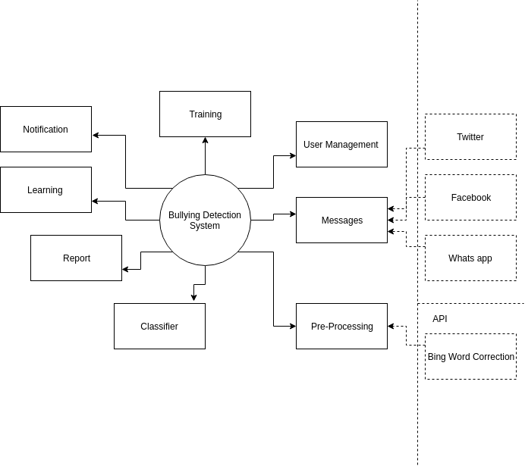
Context Diagram

Slide 25
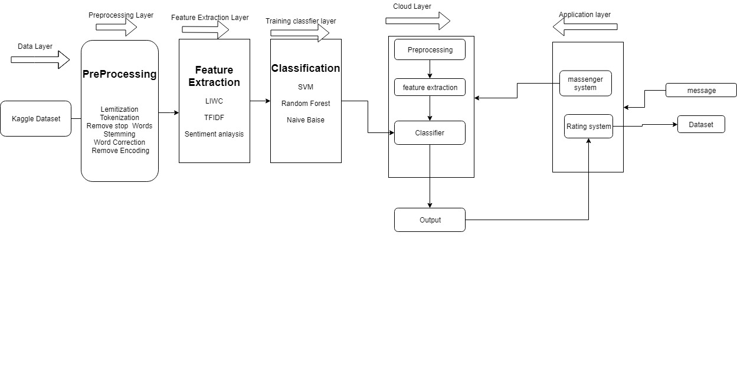
Block diagram

Slide 26
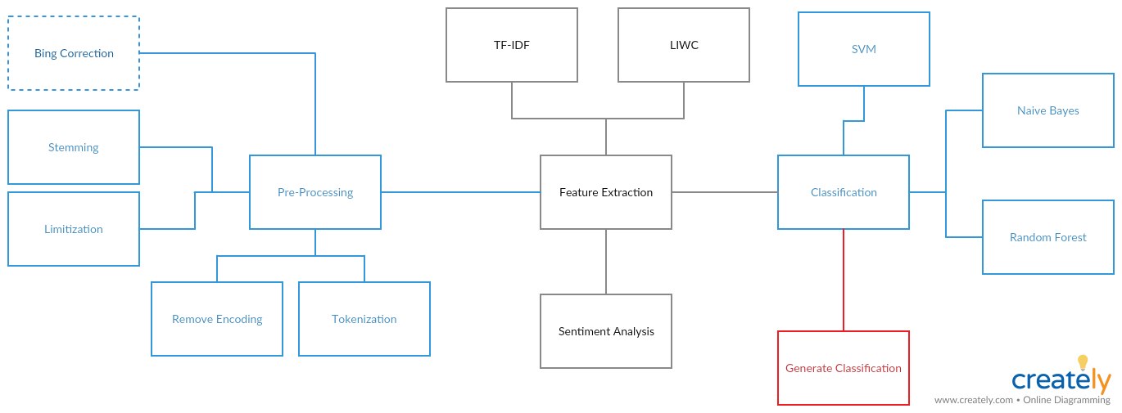
Block diagram

